Slide 1
Do Now
Grab a whiteboard.
Take out your notes, a pencil and a calculator.
Draw a periodic trend around a PTE.
Label it with the atomic property.

Slide 2
Review Day
I have selected the parts of Ch. 5 and Ch. 6 that I believe we should review the most.
Take notes and use the whiteboards to practice too.

Slide 3
Key Concepts
Orbitals
Energy Levels
Electron Configurations
Orbital Notations
C=λv and E=hv

Slide 4
Key Concepts
Bohr and Schrodinger Models
Metals, Non-Metals & Metalloids
Groups of the PTE
Ions-Groups, cations vs. anions
Periodic Trends

Slide 5
Key Concepts
Pauli Exclusion Principle
Hund’s Rule
Aufbau Principle
Emission Spectra

Slide 6
Orbitals
There are 4 e- blocks:
How many orbitals are in each?
What to they look like?

Slide 7
Energy Levels
Think rings of the Bohr Model.
D block occupies 1 less row.
F block occupies 2 less rows.
Explain…

Slide 8
Electron Configuration
Aufbau Principle:
Order of e- confinguration.

Slide 9
Write the e- Configuration
O
With Noble Gas Short Cut:
Pd

Slide 10
Valance Electrons
The electrons on the outer most energy level of an atom.
Determine bonding behavior.
Only s and p orbitals matter for this.
How many in: Pb Se Rn Md

Slide 11
Orbital Notation
Pauli Exclusion:
Hun’s Rule:
Write the Orbital Notation
S
Na

Slide 12
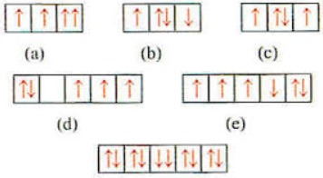
What’s Wrong? Pauli, Hund or Both?

Slide 13
C=λv and E=hv
C-constant=2.998x10^8m/s
λ-wavelength in meters
v-frequency in Hertz or 1/s
E-energy in joules
h-Plank constant=6.626js

Slide 14
Tips
Make sure that the wavelength is in meters before starting calculations.
Write knowns, unknown, equations, algebra, plug in numbers.
LABLE ANSWER WITH UNITS.

Slide 15
The energy of a wave is 2x10^(-22)j. What is the frequency of the wave?

Slide 16
The wavelength of a wave is 3x10^(-6). What is it’s energy?

Slide 17
Bohr Model
Electrons orbit the nucleus.
Orbits are the energy levels.
Draw the Bohr Model for K.

Slide 18
Schrödinger
Orbitals, not orbits.
e- has a 90% chance of being found in an orbital.
Each orbital has 1 box in orbital notation, occupied by up to 2 electrons.

Slide 19
Trends
See p. 178 for formal trends.
View the class from above (in your head)
There is a trend in the way that you, the students are arranged.
Get up and talk to people and figure it out.

Slide 20
Front Board
Door Mr. B
Windows Windows

Slide 21
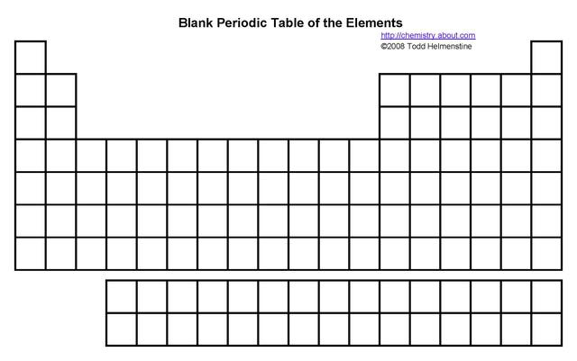
Atomic Radius

Slide 22
Ionization Energy

Slide 23
Electronegativity

Slide 24
Density

Slide 25
Melting/Boiling Point

Slide 26
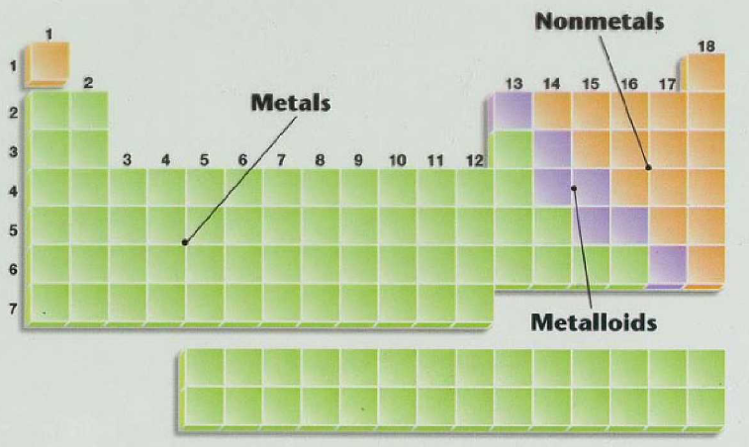
Metals, Non-Metals & Metalloids

Slide 27
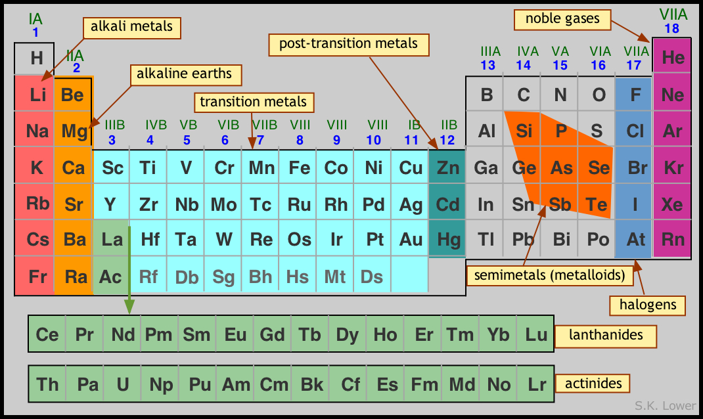
Groups of the PTE

Slide 28
Ions
Elements with a non-neutral charge.
Cations-positive charge
Anions-negative charge
Groups have (for the most part) the same ionization charges. Why?

Slide 29
Identify the Ion’s Charge
Charge of an alkaline earth metal:
Charge of a halogen:
Electron configuration of an ionized sodium atom:

Slide 30

Questions I didn’t address???

Slide 31
A wave has an energy of 3.7x10^(-18)m. Where is it on the electromagnetic spectrum?

